Slide 1
Enabling Commodity Environmental Sensor Networks Using Multi-Attribute Combinatorial Marketplaces
Kevin Lee, Murdoch University, Australia
Ahmed Alrawahi, University of Nizwa, Oman
Danny Toohey, Murdoch University, Australia
August 30th 2013
Asia Pacific Conference on Communications (APCC 2013)

Slide 2
Topic Overview
Aiming to improve the use of environmental sensor networks
Focusing on the accessibility of resources
Proposing a market mechanism
For trading environmental sensor networks
Marketplace
Resource Vocabulary
Trading algorithms

Slide 3
Background: Environmental Sensor Networks
Provide a way to integrate environmental data into applications.
Composed of ‘motes’: embedded computers with low-power radios and simple sensors.
Motes form self-organizing networks that relay data to a small number of gateways.

Slide 4
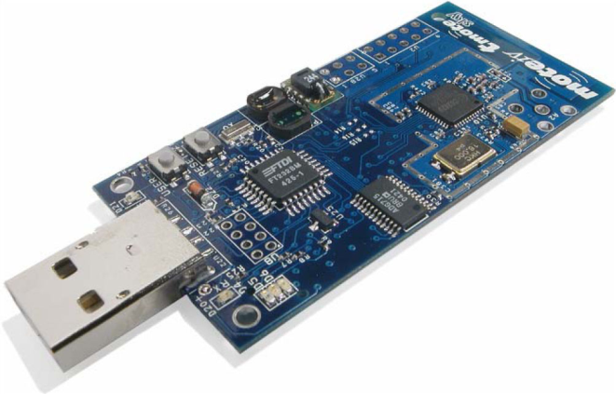
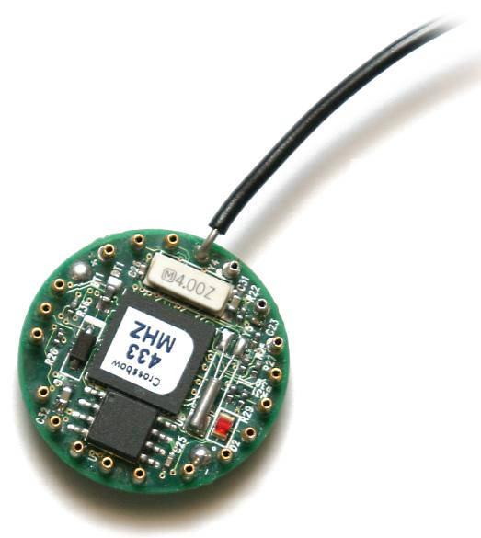
Characteristics of Sensor Networks
Varying Hardware:
CPU from 10MHz to 190MHz
RAM from 10KB to 512KB
Flash from 48KB to 4MB
Networking from 250kbps 802.15.4 up.
Varying Sensor:
Temperature, Light, Sound, Vibration
Varying Platform:
Fixed, wireless, mobile
Varying Ownership:
Individuals, governments, companies
Varying Usage Models:
Constant, periodic, one-off, emergency (reactive)
.

Slide 5
Motivation
Its hard for Environmental Sensor Network application users to access resources
Lack of standard open environmental sensor networks
Lack of a marketplace to access data and ESNs
Lack of competition for providing resources
Lack of large-scale ESN deployment

Slide 6
Aims
Enable Interoperability of ESNs
Empower Small and Medium Enterprise ESN users
Improve Service Level Agreements (SLAs)
Avoid Monopolies of ESN providers
Enable Infrastructure Innovation
Enable Application and Platform Innovation

Slide 7
The Approach: A Market for Commodity Environmental Sensor Networks
A vocabulary for describing Environmental Sensor Networks in a standard way
Enables Interoperability and consistancy
An architecture for trading Environmental Sensor Networks
Support both providers and consumers..
Algorithms for efficiently matching providers and consumers
Supporting a growing market

Slide 8
A Market for Commodity Environmental Sensor Networks Vocabulary
Simple Vocabulary to describe any environmental sensor network resource
Location L
Sensor S
Motes M
Power P
Network N
Access Characteristics A
Security S
Each resource can be described within the range of each attribute

Slide 9
A Market for Commodity Environmental Sensor Networks Trading Bundles
Each provider or consumer can represent their resource availability or requirement.
Create a tradable combinatorial bundle
e.g. B¹ = L^{l}T^{t}M^{m}S^{s}C
The process of matching providers and consumers is a combinatorial exchange problem.
i.e. exchanging bundles of combinations of attributes

Slide 10
A Market for Commodity Environmental Sensor Networks Architecture
Conceptual Model of the Proposed Architecture
Layered Architecture
Orchestration/Access Layer which maps applications to the sensor/physical layer
Trading process happens transparently
Hardware and Application agnostic

Slide 11
A Market for Commodity Environmental Sensor Networks Auction Process
To support this process algorithms are needed to match bundles from providers and consumers
Non-trivial – multiple-attribute, multiple bundles, time
Consumers submit request bundles with associated max pricing
Providers submit provision bundles with wider time availability, with associated min pricing
First consumer bundles must fall within the provider bundle availability,
Then a standard combinatorial exchange problem

Slide 12
Case Study: Scenario
Take the scenario of a high-traffic metropolitan and commercial location
Car and bus traffic
Footfall traffic
Range of Sensors
Environment – temp, light
Air – particles, gas
Human – traffic, footfall
Commercial push
Billboards, advertising, environmental

Slide 13
Case Study: Provider
Matching the vocabulary
• The Location as an absolute GPS location. It is assumed that this would not change during deployment. To support many resources in a very localised area, this must be a high resolution GPS location.
• The Sensors available on the mote is, at its most basic, just the footfall sensor.
• The Mote attribute describes the processing power of the Mote in MIPS.
• The Power attribute describes the Mote power as continuous as it is powered by mains power.
• the Network attribute describes the network characteristics as 7 out of a scale of 10 as it is on a reliable but still wireless connection.
• The Access Characteristics attribute specifies that access is through pull web service interface calls.
• The Security attribute specifies that the connection is using SSL for the web service interface call.

Slide 14
Case Study: Consumer Usage
Three broad uses of this type of environmental sensor network data:
Direct Individual Advertising and Marketing
Measuring footfall and selling street billboard space
Public Monitoring and Control
Measuring crowd movements
Environmental Impact Analysis
Performing environmental impact analysis by monitoring traffic flow

Slide 15
Summary
Proposed a market mechanism for trading environmental sensor networks
A vocabulary for describing Environmental Sensor Networks in a standard way
An architecture for trading Environmental Sensor Networks
Algorithms for efficiently matching providers and consumers
Future work will implement more mechanisms and apply to further case studies

Slide 16
Any Questions
You can also email me at kevin.lee@murdoch.edu.au

