Slide 1
Measuring the Reliability of 802.11 WiFi Networks
Kevin Lee, David Murray, Terry Koziniec and
Michael Dixon
Nottingham Trent University and Murdoch University

Slide 2
Motivation
Over 50% of the transmission time in WiFi Networks is used to ensure that errors are corrected/detected
Even with these efforts, loss rates in prior measurement studies have varied between 5% and 45%
This was an exploratory research study to find out if there were any factors which correlated with packet losses
We lose frames because the bit errors are too high to be corrected by the forward error correction (FEC) mechanism.
Which means packet repeat requests happen…
But what are the events which cause these bit errors?

Slide 3
Frame loss Possibility: Collisions
WiFi networks use a CSMA/CA protocol called Distributed Coordination Function (DCF) to share the medium.
All stations seeking access to the medium will pick a random number and count down to zero.
If a node counts to zero, it will begin transmitting (below)
All other stations, will overhear the transmission and defer access.
If two nodes pick the same random number and begin transmitting simultaneously, the result will be a collision (above)

Slide 4
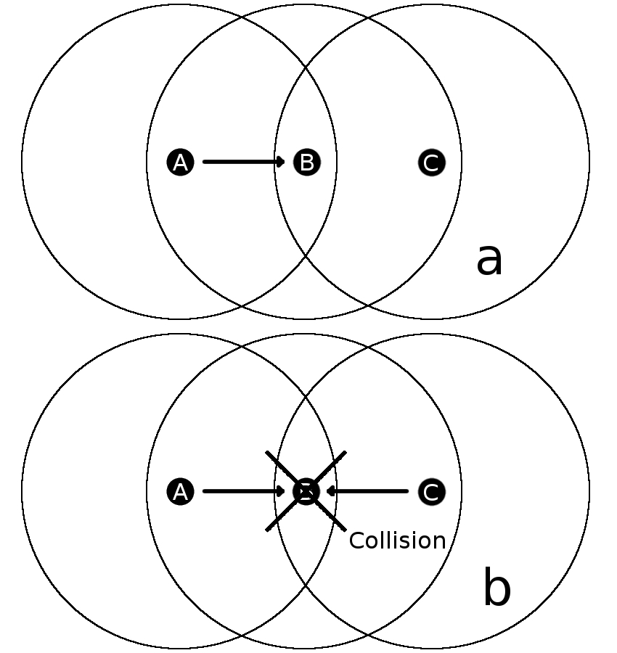
Frame loss Possibility: Hidden Nodes
Transmission errors can also be caused by hidden nodes
This occurs when two competing stations cannot overhear each others transmission
The mechanism to circumvent hidden nodes is called RTS/CTS but is turned off by default in most access points because it is too inefficient
The authors have not found any experimental evidence or observations investigating how commonly hidden node problems occur

Slide 5
Frame loss Possibility: Background Interference
Background wireless noise can be caused by various non-802.11 2.4GHz co-existing network types such as Bluetooth or Zigbee
There are also many other sources of interference which may arise from non data communications devices such as microwave ovens and cordless phones

Slide 6
Frame loss Possibility: Aggressive Rate Control
Wireless links actively modify the transmission rate by changing the Modulation and Coding Scheme (MCS) which determines the number of bits per symbol and amount of FEC.
A frequently used open source rate control mechanism called Minstrel rate control algorithm continuously probes the optimal data rate limit and a degree of packet loss is not only inevitable, but a necessary consequence of finding and utilising the most efficient rate.
While it is difficult to know the precise usage of different rate control algorithms in current 802.11 WiFi networks, it is likely that most algorithms will allow or cause a degree of packet loss.

Slide 7
Research Aim
This paper re-examines transmission success rates and the range of factors that correlate with packet losses.
Careful analysis may provide clues to help locate the predominant cause of packet loss.
Understanding why wireless networks lose packets is very important and it is possible that much needed experimentation in this area has been neglected due to the methodological difficulties in obtaining data from which generalised conclusions can be made.
The significance of this study is the volume of wireless packet captures which have been obtained from a wide range of network types and the analysis of loss rates against modulation, frame size and airtime.

Slide 8
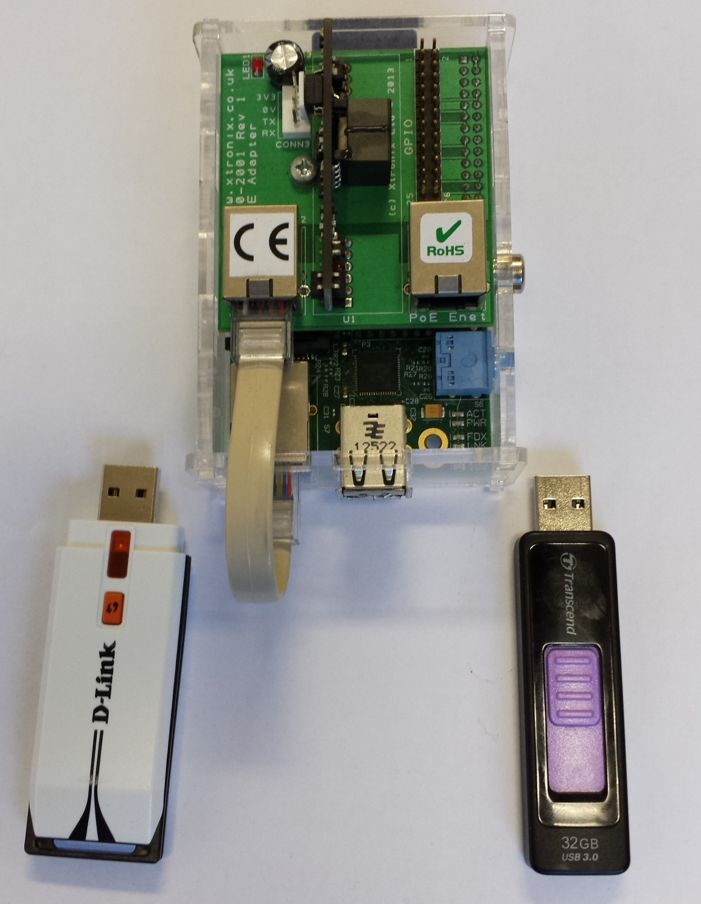
Study Methods
Both passive and active methods involved the use of monitor mode 802.11 network cards to capture over the air traffic.
Monitor mode allows the capture of raw link layer information.
A Power over Ethernet Raspberry Pi was used to capture and save the data to a 32GB USB drive
This device was placed less than 1m away from the access point and only transmissions from the AP were used for analysis

Slide 9
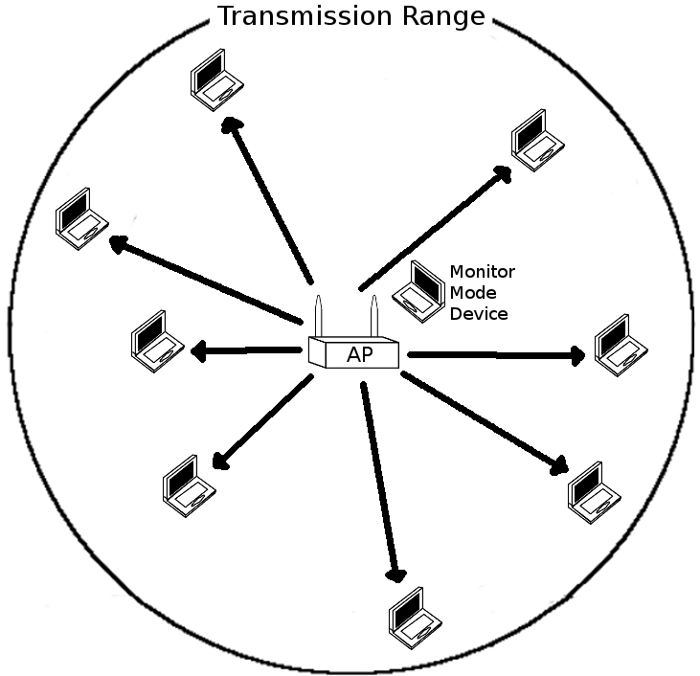
Methods: passive
The goal of this study was to obtain real world measurements on packet losses in WiFi networks. Two approaches were taken: passive and active
The passive approach captures the effects of a wide range of devices and settings
We captured the transmission from 7 different University and home WiFi Access points (for a week)
We looked for any packet loss from the AP (look for retransmission bit)
Murdoch University Ethics permit No: 2014/149

Slide 10
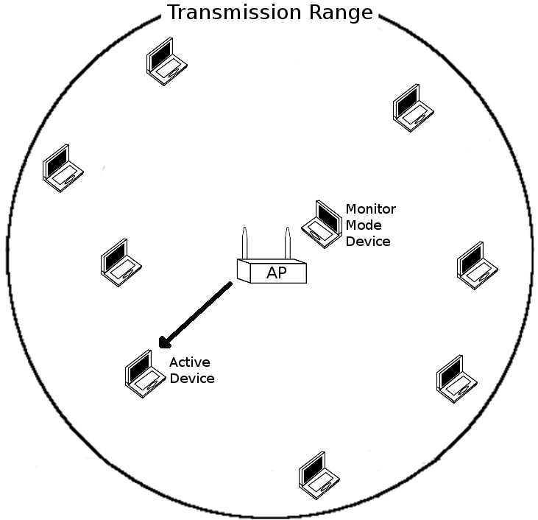
Methods: active
The active method trades the range of devices and settings for greater control over the variables in use
We captured the data that was being triggered by a single randomly planted device which generated ICMP transmissions based on a computer script
We were able to control the packet size in the active tests
We observed the packet loss in only these packets (of the size and from the AP to the active device)

Slide 11
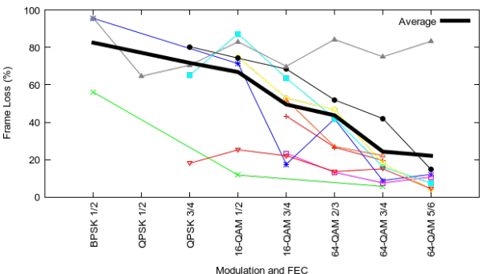
Results: Coding Rate (passive)
The table above shows the coding rate for 802.11a/g/n transmissions.
The figure below shows that frames using more sophisticated coding methods suffer from fewer losses

Slide 12
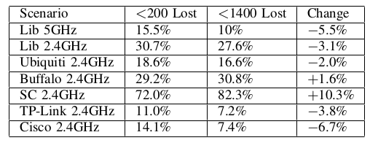
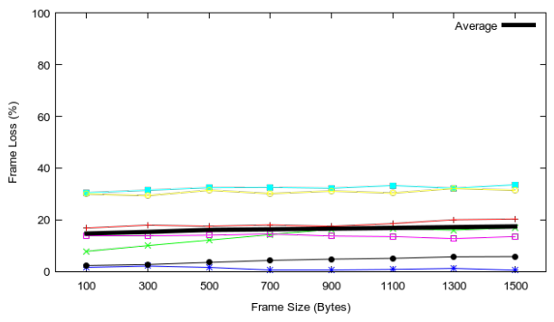
Results: Frame Size (passive +active)
The table to the right shows the packet loss rate for packets in the passive measurement study - only frames <200 bytes and >1400 bytes were found in significant quantities
The active test shown enabled control of the packet sizes so different sizes were tested in equal proportions
The frame loss rate did not change significantly with the frame size

Slide 13
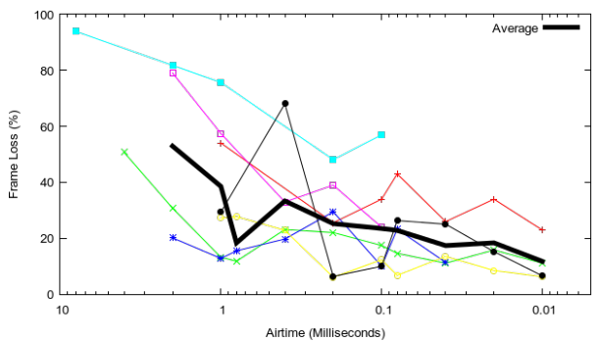
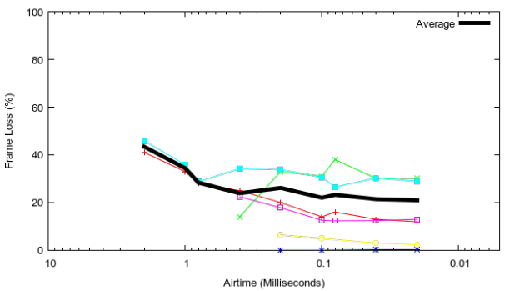
Results: Airtime
The figures to the right shows how the frame loss rate changed with the air time
The top figure shows the results of the passive test whereas the lower figure shows the results of the active test.
Note the logarithmic scale
Packets that spend less time in the air are less likely to get lost…
(due to modulation and airtime – not packet size)

Slide 14
Concluding Remarks (1/2)
The number of packet losses occurring, in this and prior measurement studies large and requires serious consideration.
This study suggests that frames, which spend less time in the air, were less likely to be lost
Frames transmitted at high data rates, were also more likely to be successful than those transmitted at low data rates.
Both the passive and active studies found that the size of the packet, in bytes, did not significantly effect the probability of loss.

Slide 15
Concluding Remarks (2/2)
While this study alone does not permit any strong conclusions about the precise cause of packet loss, there are implications for a number of research areas.
As the results suggest that the frame size has little effect on the loss rate, we suggest that larger wireless frames, may have a highly beneficial effect on overall throughputs.
If packet loss does not increase significantly with larger packets the the Internets MTU could be increased with significant performance benefits

Slide 16
Future work
Future research could investigate the extent to which the packet size effects the loss rate in 3G and 4G networks.
If the major cause of frame loss was hidden nodes or continuous background noise then losses would have increased exponentially with the size.
As this did not occur we suggest that there must be other reasons for losses in the capture
Future work will try to investigate the preamble, as well as head on collisions (picking the same contention slot) - failures in both these mechanisms would be size agnostic
A direction of work involves isolating the Wifi AP from all radio.

Slide 17
Thank you Any Questions?

