Slide 1
Extending Sensor Networks into the Cloud using Amazon Web Services
Dr. Kevin Lee, Murdoch University, Australia
David Murray, Murdoch University, Australia
Danny Hughes, XJTLU, China
Wouter Joosen, Leuven University, Belgium
25th November, 2010 IEEE International Conference on Networked Embedded Systems for Enterprise Applications 2010

Slide 2
Topic Overview
The benefits and feasibility of Integrating Wireless Sensor Networks and Cloud Computing
Wireless Sensor Networks
Cloud Computing
Location Specific
Resource constrained
Expensive resource cost
Inflexible resources
Location independent
Resource rich
Inexpensive resource cost
Elastic resources
What is needed
To bind the two together?

Slide 3
The Challenge 1
Integrating the Sensor Networks with Cloud Computing would mean:
Exposing Sensor Networks as a 1st class Cloud entity:
Exposing Sensor Network resources as a web-service
Individual Sensors
Individual Nodes
Sub-nets or Entire Sensor Networks
Shared access to Sensor Network resources
Pay per use and on-demand

Slide 4
The Challenge 2
Integrating Sensor Networks with Cloud Computing would mean:
Giving Sensor networks the ability to seamlessly utilise cloud resources:
Unlimited and elastic storage
Unlimited and elastic processing capability
The ability to provision resources quickly when an incident occurs
For example, a river-flow monitoring application can quickly provision more resources when a flood is detected

Slide 5
The Benefits
Integrating Wireless Sensor Networks and Cloud Computing could enable:
dealing with dynamic loads
reducing overall cost in deployment
enabling the creation of new application types.
Potential creation of a competitive market for sensor network providers

Slide 6
Background: Sensor Networks (WSN)
Provide a way to integrate environmental data into applications.
Composed of ‘motes’: embedded computers with low-power radios and simple sensors.
Motes form self-organizing networks that relay data to a small number of gateways.

Slide 7
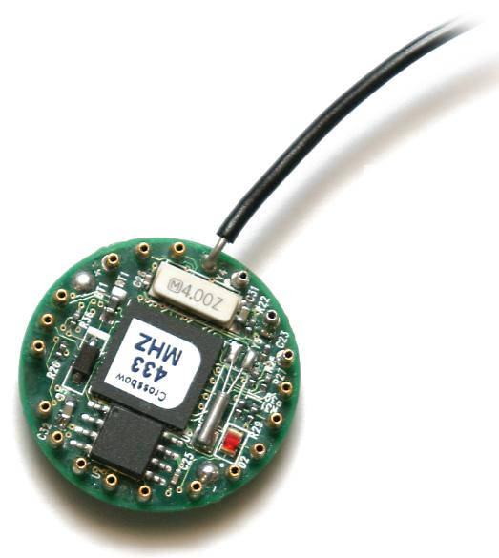
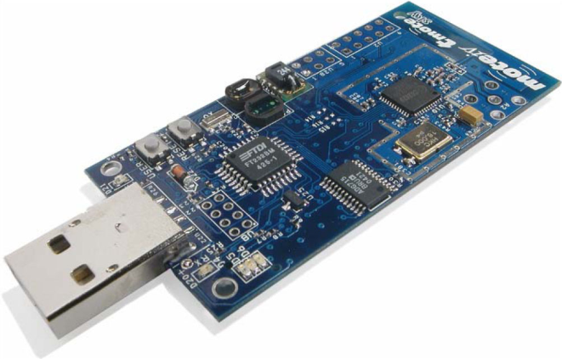
Characteristics of Sensor Networks
Hardware:
CPU from 10MHz to 190MHz
RAM from 10KB to 512KB
Flash from 48KB to 4MB
Networking from 250kbps 802.15.4 up.

Slide 8
Operating Systems
TinyOS: a static component based Operating System built using the NesC language.
Contiki: a modular operating system built using standard C.
Squawk: a Java-based operating system that supports the Java ME MIDP 1.0 specification.
All of these platforms support some form of IPv6 networking.
Therefore there is inherent operating system support for interaction with external services!

Slide 9
Background: Cloud Computing
Reasonable definition:
Abstracted or virtualized resources.
Elastic resource capacity.
Programmable self-service interface.
Usage-based pricing model.

Slide 10
Characteristics of Cloud Computing
Practically, Cloud offers:
Raw virtualized resources
(Infrastructure as a Service IaaS)
High-level supported services
(Platform as a Service)
Complete turnkey applications
(Software as a Service)
Flexible virtualized storage
(Storage as a Service)
A wide array of service types to support many types of application!

Slide 11
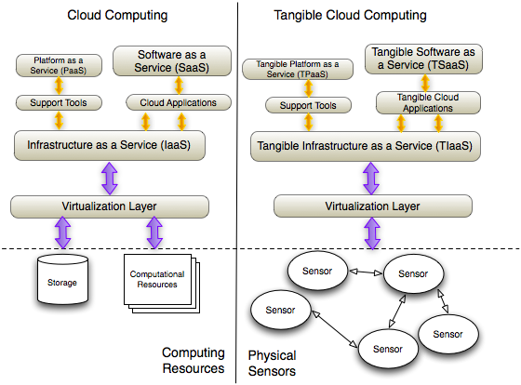
The Vision

Slide 12
Elastic Computational Capabilities for Environmental Modeling
We believe Cloud Computing resources could be most useful in certain environmental applications
Currently implementation of back-end resources can be problematic. The tight-coupling between the application and the environment discourages resource availability:
Consider a Flood-monitoring application:
Normally, low activity, low processing requirements, timeliness of flood-predictions not critical.
Under flood conditions, flood-predictions become critical.
Using traditional methodologies, resources would be manually provisioned and may not be able to respond fast enough.
Integrating Cloud Computing with Sensor Networks, resources can be provisioned dynamically and rapidly.

Slide 13
Can Cloud Computing Resources Support the Dynamic resource provisioning needed by environmental applications?
How can this be realised?
Can we quantify the support for this?

Slide 14
Realising Computational Elasticity in Amazon EC2
Amazon EC2
Elastic Computing Cloud
Designed to provide resource flexibility
Allows customers to launch and manage virtual machines on Amazon’s infrastructure
Through web-service APIs, tools or a web-based management console.
Pay per-use, and for the type of machine being used.

Slide 15
Realising Computational Elasticity in Amazon EC2
The process of launching instances on EC2 is the same using any of the management interfaces, as follows:
An Amazon Web Service account must be created, enabling the user to pay for resources based on usage.
An Amazon Machine Image (AMI) must be chosen.
Operating system images that become instances when launched.
Normal and micro instances for a variety of CPU and Memory configurations.
Large range available, including those prepared by:
Amazon
Third-parties
built by the user, for example, to host a specific model.
Key pairs should be created that allow secure connections to be made to the instance.
A security group should be defined that specifies what services can be accessed on the instances and who can access them.
Launching of the instance takes place. Once the instance is setup a user can connect to it (e.g. using SSH) and configure it for the required application scenario.

Slide 16
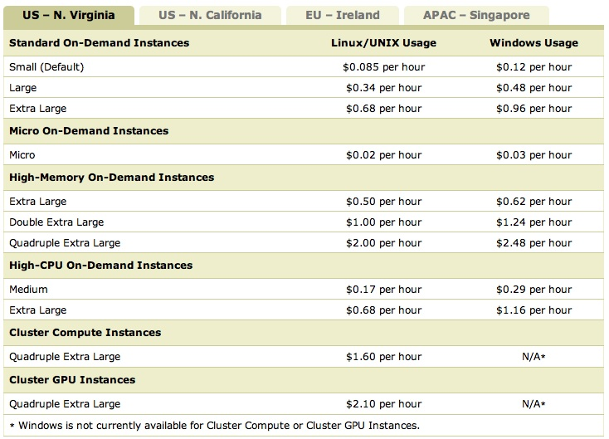
Using EC2: Selecting a machine

Slide 17
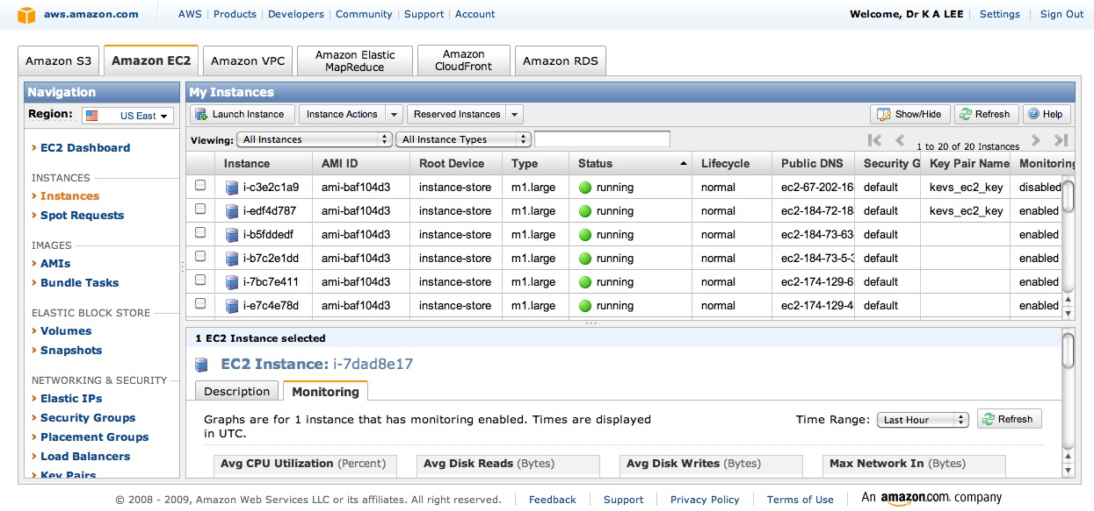
Using EC2:Launching instances

Slide 18
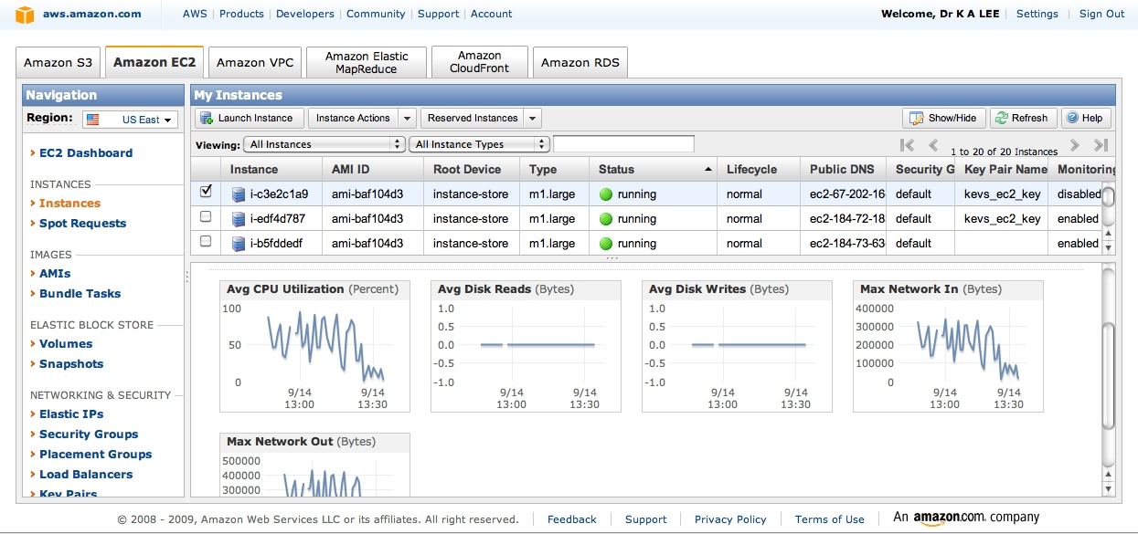
Using EC2:Monitoring running instances

Slide 19
Amazon EC2 Web-service Interface
The EC2 web-services API
allows these tasks to be completed programmatically
using standard HTTP calls
with short XML descriptions or HTTP Queries.
The most lightweight of these being HTTP Queries using the RESTful paradigm.

Slide 20
Amazon EC2 Web-service Interface
For example, to list all available Ubuntu AMIs the HTTP Query would be the following:
http://ec2.amazonaws.com/
?Action=DescribeImages
&User.1=ubuntu
&...auth parameters...
This returns an XML document listing all the available Ubuntu AMIs along with specific details such as a description of the AMI, device mappings and kernel version

Slide 21
Amazon EC2 Web-service Interface
Instances can be started using simple a HTTP Query as follows:
http://ec2.amazonaws.com/
?Action=RunInstances
&ImageId=ami-e480aa90
&MaxCount=1
&MinCount=1
&KeyName=gsg-keypair &Placement.AvailabilityZone=eu-west-1b
&...auth parameters...
Similarly, any operation involving EC2 services can be controlled using SOAP or HTTP Queries
Easy to integrate into any application

Slide 22
Using EC2 to support dynamism
Amazon EC2 service has built-in support for dealing with dynamic loads
Uses auto scaling.
User-defined triggers to automatically control the launching and shutting down of instances.
Users define groups, with associated triggers that will automatically scale EC2 resources based on:
Bandwidth
CPU utilisation.

Slide 23
Using EC2 to support dynamism
To support a trigger:
Amazon CloudWatch service is configured to monitor the usage of the instance group.
Cloudwatch measures
Bandwidth
CPU utilisation.
A trigger is configured to respond to an increase/decrease in utilization through the use of two parameters:
Period is the interval at which resource usage is monitored
BreachDuration is the amount of time the metric is required to be above the trigger point before starting another instance.
By adjusting these parameters:
Auto scaling can respond rapidly to small changes
Or, long-term trends
Dependent on the user’s value of performance vs cost!

Slide 24
Using EC2 to support dynamism
Example (1) defines a new autoscaling group with a maximum of 10 instances and (2) sets the scaling algorithm to increase the number of instances when the CPU utilization reaches 50% for more than 300 seconds.
http://autoscaling.amazonaws.com/
?AutoScalingGroupName=sensorappn &LaunchConfigurationName=e480aa90
&MinSize=0
&MaxSize=10
&Cooldown=0
&AvailabilityZones.member.1=eu-west-1b &Action=CreateAutoScalingGroup
http://autoscaling.amazonaws.com/
?AutoScalingGroupName=sensorapn
?TriggerName=50percent
&MeasureName=CPUUtilization
&Statistic=Average &Namespace=AWS/EC2
&Period=50
&LowerThreshold=0
&LowerBreachScaleIncrement=-1
&UpperThreshold=50
&UpperBreachScaleIncrement=1
&BreachDuration=300
&Action=CreateOrUpdateScalingTrigger

Slide 25
Using EC2 to support dynamism
Characteristics of EC2 Autoscaling:
EC2 Autoscaling service is AMI agnositic – only concerned with load present
The AMI and application must be designed to support parallel computation and instance replication.
the environmental models which use sensor network-derived data are inherently parallel and would thus benefit from using cloud resources.
When increasing the number of instances for an application the current instance and state is not replicated, instead, fresh AMIs are instantiated and data directed to them using the load-balancing algorithm.
The AMI must be customised to support the application. This can be completed in two ways.
Configure an AMI to contain the application setup ready to receive data.
Configure the AMI to retrieve the application specifi-cation from Amazon’s Simple Storage Service (S3) on instantiation and setup the application.
Using both these methods, the Amazon AutoScaling service will be able to balance the load across multiple instances;
increasing and descreasing the number of instances as necessary

Slide 26
Quantifying Elasticity of Amazon EC2
To evaluate if EC2 can effectively:
load-balance when subjected to dynamic loads
Launch new instances in a timely fashion
Experiment Setup
A single AMI was prepared using Ubuntu 10.04/Apache 2.2.14. Stored on Amazon Simple Storage Service (S3) ready to be instantiated by EC2.
A single instance of this AMI was instantiated on a standard machine type m1.large which has 4 64-bit EC2 Computer Units and 7.5GB of memory.
Amazon CloudWatch was turned on to enable the collection of statistics from the instance.
Low CPU threshold 25%, high utilisation 40%
BreachDuration, 2 minutes

Slide 27
Quantifying Elasticity of Amazon EC2
Experiment:
Load is started at the level of 10 concurrent requests per second
then increased every 10 minutes over 80 minutes.
The level of the load applied, the actual CPU usage on each instance, the number of instances available and transaction statistics were recorded.

Slide 28
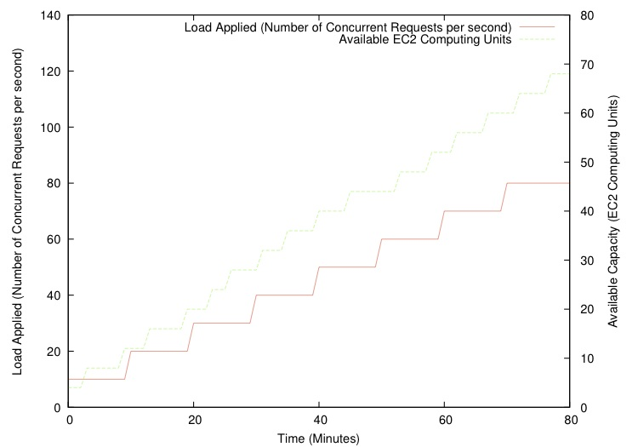
Quantifying Elasticity of Amazon EC2
Number of Available Amazon Compute Units with Increasing Load Applied being Applied

Slide 29
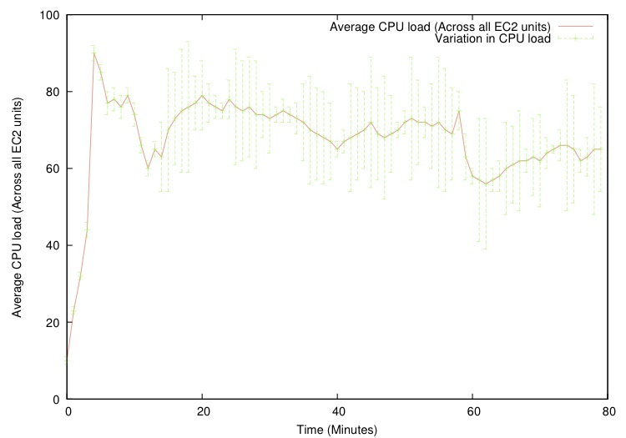
Quantifying Elasticity of Amazon EC2
Average CPU Usage on all amazon compute units over time

Slide 30
Experiment Summary
The load-balancing service can gracefully increase the number of instances to support increased load.
Load is spread relatively evenly across all instances.
Therefore, Amazon EC2 is appropriate to support the dynamic load requirements of applications

Slide 31
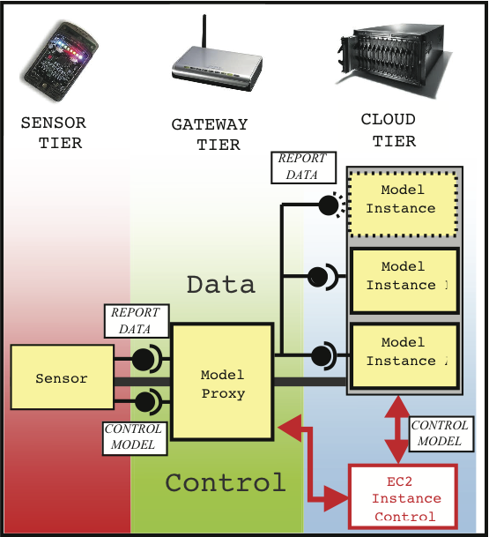
Towards an Integrated Environmental Monitoring and Modeling System
Currently being built using LooCi WSN Component model
Multi-tier architecture
Sensor-Tier
Gateway-Tier
Cloud-Tier
Model Proxy manages Cloud-Tier support for the Application
Components are bound together across the 3 tiers
Practically as messages on loosely-coupled event bus

Slide 32
API for Model Proxy
Simple API for controlling the Cloud-Tier.
Model Control Methods:
modelRef startExtensibleModel()
stopExtensibleModel(modelRef)
setExpandThreshold(cpuLevel)
setContractThreshold(cpuLevel)
setBreachDuration(duration)
incrementCapacity(modelRef)
decreaseCapacity(modelRef)
Data Relay Methods:
report(sensorData, modelRef)

Slide 33
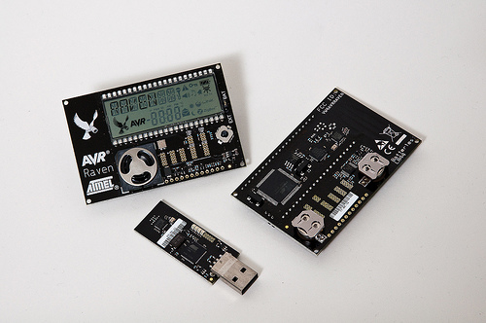
Next Step: Deployment
Further refinement of the Model
Lightweight sensors and cloud services, using:
Atmel Raven Nodes running Contiki
Amazon EC2 services
Applications:
Flood-monitoring
Fire-monitoring

Slide 34
Topics for Discussion
Energy considerations for the integration of Cloud Computing and Sensor Networks:
Normally you try to reduce the amount of data passing through the sensor network…
Potential appropriate applications
We have focused on the vision and technical part
Next steps is to explore Application Scenarios and their effect on the Model!
Happy to hear your thoughts during the conference!

Slide 35
Summary
Integrating Wireless Sensor Networks and Cloud Computing will enable:
dealing with dynamic loads
reducing overall cost of deployment
enabling the creation of new application types.

Slide 36
Any Questions?

