Slide 1
Trusted Routing for Resource-Constrained Wireless Sensor Networks
Dr. Kevin Lee,
Khaled Daabaj, Michael Dixon, Terry Koziniec,
Murdoch University
December 12th 2010
TrustCOM 2010: Sixth IEEE/IFIP International Symposium on Trusted Computing and Communications

Slide 2
Topic Overview
How to trust routing in resource-constrained Wireless Sensor Networks
Why TrustCOM?
Trust isn’t just security – can be trusting the reliability of some medium
In our context it is also trusting a WSN to be reliable to support its applications
What does this mean for WSNs?
Energy efficiency
Minimising transmissions
Guaranteed transmissions
What is needed to meet this goals?

Slide 3
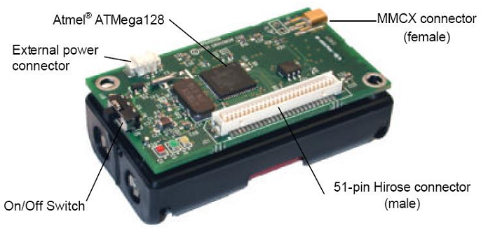
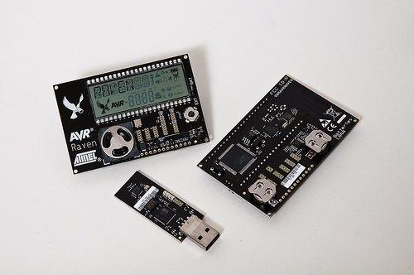
BACKGROUND
Wireless Sensor’s
Provide a way to integrate environmental data into applications.
Composed of ‘motes’: embedded computers with low-power radios and simple sensors.
Wireless sensor nodes can
  Sense a physical phenomenon
  Process the sensed values
  Communicate the sensed values among neighbors
  Respond to physical phenomenon using actuators
  Constrained resources
  CPU from 10MHz to 190MHz
  RAM from 10KB to 512KB
  Flash from 48KB to 4MB
  Networking from 250kbps 802.15.4 up.
For Wireless Sensors
  Energy conservation…
Mica2
TelosB
Atmel
Raven

Slide 4
BACKGROUND
Wireless Sensor Networks
Definition
  Motes form self-organizing networks that relay data to a small number of gateways.
  WSN is a collection of distributed autonomous wireless sensor nodes which can self-organize to form an unattended network to cooperatively monitor physical or environmental conditions
Features
  Multihop communication
  Dynamic topology
  Nodes work as routers
Limitations
  WSNs as a whole have the same resource constraint issues as individual nodes

Slide 5
Challenges in Wireless Sensor Networks
Resource limitations
  Limited power
  Limited computation capabilities
  Limited bandwidth ~ 250 Kbps or less for some motes
Nature of communication
  Time-varying dynamic links
    nodes appear and disappear
    Nodes move location
  Local broadcast with collisions
  Wireless radio multipath fading effects
  Routing Protocols have to deal with these challenges!
5

Slide 6
Research Focus
The enhancement of current reliability-oriented routing protocols
Take into account:
  Energy Status of the nodes
  Overall energy status of the WSN

Slide 7
Research Focus
Reliability-Oriented Routing Protocols
Pure reliance on reliability metrics:
  Channel State Information (CSI) such as Receive Signal Strength Indicator (RSSI) and Link Quality Indicator (LQI),
  or on delivery cost estimates such as Expected Transmission Count (ETX)
Existing TinyOS-based collection tree routing protocols do not explicitly employ energy or load balancing (based on energy-usage) in their routing schemes
Problems
Frequent use of optimal routes lead to:
Imbalanced workload on relay nodes
Topological bottleneck tree-based routing
Network partitioning and routing-hole problem
Topological bottleneck with respect to upstream nodes
7

Slide 8
The proposed Trustworthy Energy Efficient Routing Framework
Routing Framework
reliable load-balancing routing (RLBR)
Takes into account the metrics:
Remaining battery capacity (energy-aware)
Channel state information (reliability-oriented)
Number of hops (minimum end-to-end delay)
Aggregated packets (minimum transmissions)
Proposed Routing Scheme Framework
8

Slide 9
The proposed Trustworthy Energy Efficient Routing Framework
Minimizing Packets Transmissions
Since more than one data packet being aggregated, the resulting aggregated packet must be dispatched to ensure the aggregated packets’ minimum deadlines.
Aggregated packets with different deadlines at a relay sensor node must be dispatched as soon as one of the encapsulating packets reaches its preset deadline. The deadline must be the minimum appropriate dispatch time that satisfies the accumulated times

Slide 10
The proposed Trustworthy Energy Efficient Routing Framework
Energy Depletion Rate
To consider the benefit of energy balancing of the proposed routing scheme, it is instructive to allow gauging of the energy discharge behavior in terms of energy depletion rate of a sensor node.
The total residual energy capacity of a sensor node’s battery is divided into energy levels.
To ensure a longer network lifetime, the strategy of minimizing the variance in energy capacity levels is employed to dissipate up all batteries powers uniformly to avoid some nodes suddenly running out of energy and disrupting the network.
10

Slide 11
The proposed Trustworthy Energy Efficient Routing Framework
Overhearing-Based Packet Aggregation
Adjacent nodes can exploit unavoidable overhearing of neighboring nodes’ traffic to improve the selection of parent nodes and uncongested data aggregators. In this case, node 1 can move to node 4.
Since more than one data packet being aggregated, the resulting aggregated packet must be dispatched to ensure the aggregated packets’ with minimum deadlines.
Overhearing of Neighborhood Traffic
11

Slide 12
Performance Evaluation
Evaluation Settings
Outdoor Experimental Testbed
- Outdoor interference-prone environment
- 30 static randomly deployed TelosB motes
- Single fixed perimeter sink
- Network stack: TinyOS IEEE802.15.4 (CSMA) on CC2420 2.4GHz radio
NS-2 Simulations
- 100 static sensor nodes in a square sensor field of 10x10 grid
- Various scenarios of different number of source nodes
- IEEE 802.15.4 with bandwidth of 250Kbps
- Multipath shadowing propagation model
- CC2420 radio energy model
Benchmarking
- Comparisons with TinyOS-2.x MultihopLQI collection routing protocol
- Simulations validate the experiments
12

Slide 13
Experimental Observations
Network Connectivity
MultihopLQI uses only link quality information at the physical layer of each beacon individually. This leads MultihopLQI to inappropriately react with the asymmetric links as child sensor nodes might not get their packets acknowledged.
higher per-hop packet loss causes MultihopLQI to increase packet retransmissions to deliver the packet successfully towards the base station; thereby resulting in larger amount of energy expenditure.

Slide 14
Experimental Observations (Cont.)
End-to-End Packet Delivery Performance
When a link is broken at 100ms within a short-term transmission period, the proposed scheme provides a faster recovery from broken links.
During long-term transmission periods, the beaconing rate of route messages in the proposed scheme is slightly increased compared to MultihopLQI due to destroyed route. It rapidly reconstruct a routing path on an alternative route

Slide 15
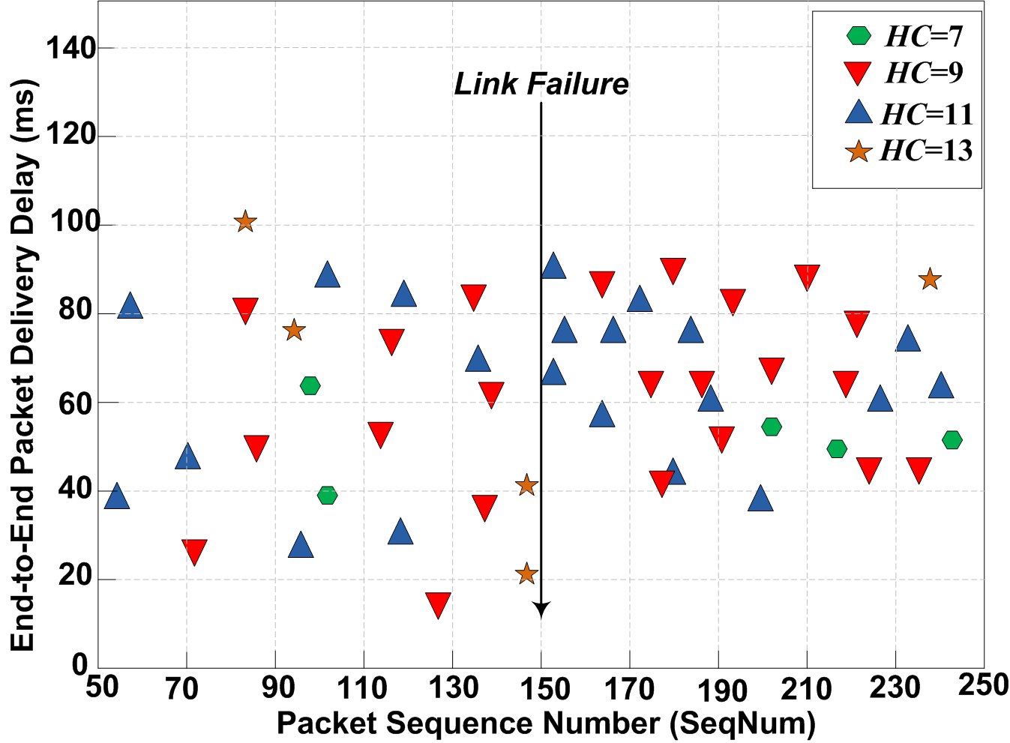
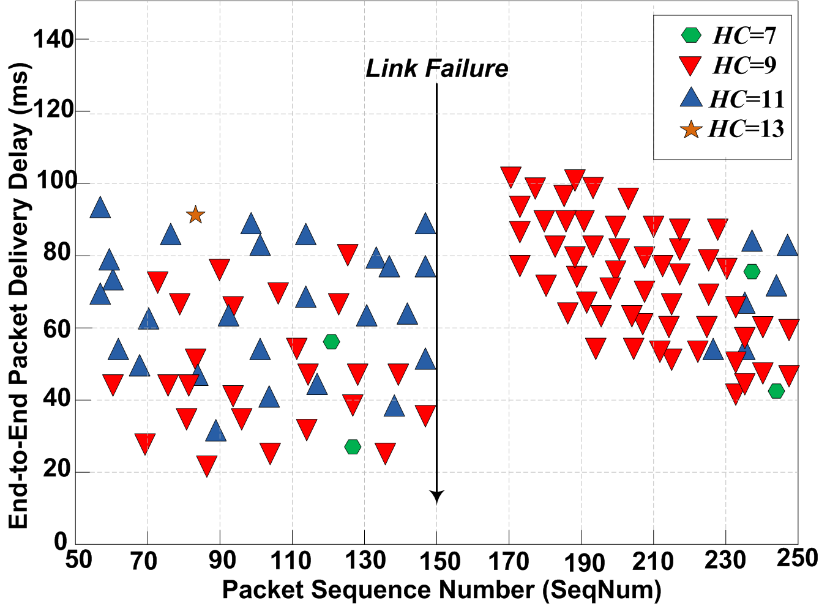
Experimental Observations (Cont.)
End-to-End Packet Delivery Performance (cont.)
Since MultihopLQI keeps a state of one parent at a time, it is incapable of rapidly recovering from a broken route
The proposed responds quickly to recover from a broken route as it maintains an alternative route to compensate the failed one. This new constructed route is used temporarily as a backup route to deliver source-originated data packets in timely manner towards the base station. However, the hop count (hc) might increase
Route Recovery Delay in the Proposed Scheme
Route Recovery Delay in MultihopLQI
15

Slide 16
Experimental Observations (Cont.)
Packet Delivery Cost
Over long run, the proposed scheme broadcasts fewer route/control messages as a result of minimising route message transmissions using adaptive beaconing. This leads to less energy consumed for route messages transmissions required for delivering data packets successfully towards the sink.
To estimate the average amount of energy consumed by relay sensor nodes for delivering a data packet towards the base station, the packet delivery cost is used as a routing overhead metric.
16

Slide 17
Simulations Results
Functional Network Lifetime
Due to the low volume of control and data packets transmitted throughout the network, the proposed scheme results in a slower and a more graceful linear degradation of the network lifetime.
17

Slide 18
Simulations Results (Cont.)
Average Dissipated Energy
The proposed scheme dissipates less energy for the same number of source nodes. The energy dissipation increases gradually as the number of generating nodes grows.
18

Slide 19
CONCLUSION AND FUTURE WORK
Conclusion
Improved reliability and packet delivery
Improved energy usage and efficient utilization of sensor node’s resources
Energy balance is beneficial for network lifetime extension
It allows for adapting the amount of traffic to the fluctuations in network connectivity and energy expenditure
Ongoing work
Comparisons with energy-aware routing protocols
Adaptability to mobile wireless sensor networks

Slide 20
Any Questions?
Primary Author: Khaled Daabaj k.daabaj@Murdoch.edu.au

