Slide 1
Reliable Routing for Low-Power Smart Space Communications
Dr. Kevin Lee,
Khaled Daabaj, Michael Dixon, Terry Koziniec,
Murdoch University
December 9th 2010
6th International Symposium on Wireless sensor network Technologies and Applications for Smart Space (WTA 2010)

Slide 2
CONTENTS
Background
Challenges in Sensor Networks
Problem Statement
The Proposed Scheme
Performance Evaluation
Conclusion and Future Work
WTA 2010

Slide 3
BACKGROUND
Smart Space (SS)
Smart Space (SS)
  Embedded technology
  • Smart nodes: sensing, actuating, communicating, computing
  Wirelessly networked
  • Low-power RF
  • Low data rate
  Collaborative networking
• Autonomous operation
• Adaptive data collection
  Examples
  • Smart sensor networks for home automation
  • Medical body sensor networks
3

Slide 4
BACKGROUND (Cont.)
Wireless Sensor Networks
Definition
  WSN is a collection of distributed autonomous wireless sensor nodes which can self-organize to form an unattended network to cooperatively monitor physical or environmental conditions
Features
  Multihop communication
  Dynamic topology
  Nodes work as routers
Limitations
  Constrained resources

Slide 5
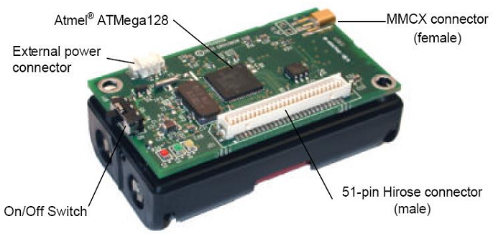
BACKGROUND (Cont.)
Wireless Sensor Networks
Sensor networks are gaining popularity due to their wide variety of applications, e.g., military, industrial, environmental, etc.
Tiny, low-cost, low-power wireless sensor nodes
Mica2 TelosB
Wireless sensor nodes can
  Sense a physical phenomenon
  Process the sensed values
  Communicate the sensed values among neighbors
  Respond to physical phenomenon using actuators
5

Slide 6
Challenges in Sensor Networks
Resource limitations
  Limited power
  Limited computation capabilities
  Limited bandwidth ~ 250 Kbps (TelosB motes)
Nature of communication
  Time-varying dynamic links
  Local broadcast with collisions
  Wireless radio multipath fading effects
6

Slide 7
Problem Statement
Reliability-Oriented Routing Protocols
Pure reliance on reliability metrics: Channel State Information (CSI) such as RSSI and LQI, or on delivery cost estimates such as ETX
Existing TinyOS-based collection tree routing protocols do not explicitly employ energy or load balancing in their routing schemes
Problems
Frequent use of optimal routes lead to:
Imbalanced workload on relay nodes
Topological bottleneck tree-based routing
Network partitioning and routing-hole problem
Topological bottleneck with respect to upstream nodes
7

Slide 8
The Proposed Scheme
Reliable Multiple-Metric Routing
Remaining battery capacity (energy-aware)
Channel state information (reliability-oriented)
Number of hops (minimum end-to-end delay)
Aggregated packets (minimum transmissions)
Proposed Routing Scheme Framework
8

Slide 9
The Proposed Scheme
Overhearing-Based Packet Aggregation
Adjacent nodes can exploit unavoidable overhearing of neighboring nodes’ traffic to improve the selection of parent nodes and uncongested data aggregators. In this case, node 1 can move to node 4.
Since more than one data packet being aggregated, the resulting aggregated packet must be dispatched to ensure the aggregated packets’ with minimum deadlines.
Overhearing of Neighborhood Traffic
9

Slide 10
Performance Evaluation
Evaluation Methodology
Experimental Testbed
- Outdoor interference-prone environment
- 30 static randomly deployed TelosB motes
- Single fixed perimeter sink
- Network stack: TinyOS IEEE802.15.4 (CSMA) on CC2420 2.4GHz radio
Large-Scale Simulations
- 100 static sensor nodes in a square sensor field of 10x10 grid
- Various scenarios of 30, 50 and 70 source nodes
- IEEE 802.15.4 with bandwidth of 250Kbps
- Multipath shadowing propagation model
- CC2420 radio energy model
Benchmarking
- Comparisons with TinyOS-2.x MultihopLQI collection routing protocol
- Simulations validate the experiments
10

Slide 11
Experimental Observations
Network Connectivity and Link Dynamics
Due to pure reliance on link quality, MultihopLQI deals inappropriately with the asymmetric link problem as child sensor nodes might not get their packets acknowledged
Based on LQI, sensor node 14 is in the opposite direction of where the sink is located but it is selected as a parent for node 16 instead of selecting node 19 and constructs the optimal route
Using averaged link quality values allows node 1 to switch to reachable node, e.g., node 2, to be its new valid parent after maximum transmission failures due to link asymmetry and transmission range between nodes 1 and 4.

Slide 12
Experimental Observations (Cont.)
Recovery from Link Failures
When a link is broken at 100ms within a short-term transmission period, the proposed scheme provides a faster recovery from broken links.

Slide 13
Experimental Observations (Cont.)
Route Messages vs. Link Failure
During long-term transmission periods, the beaconing rate of route messages in the proposed scheme is slightly increased compared to MultihopLQI due to destroyed route. It rapidly reconstruct a routing path on an alternative route
13

Slide 14
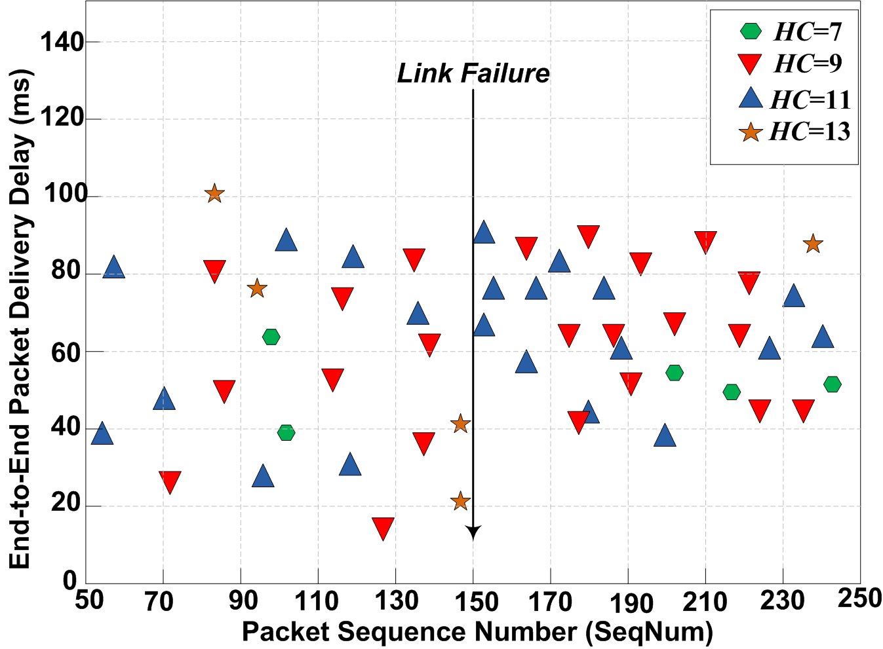
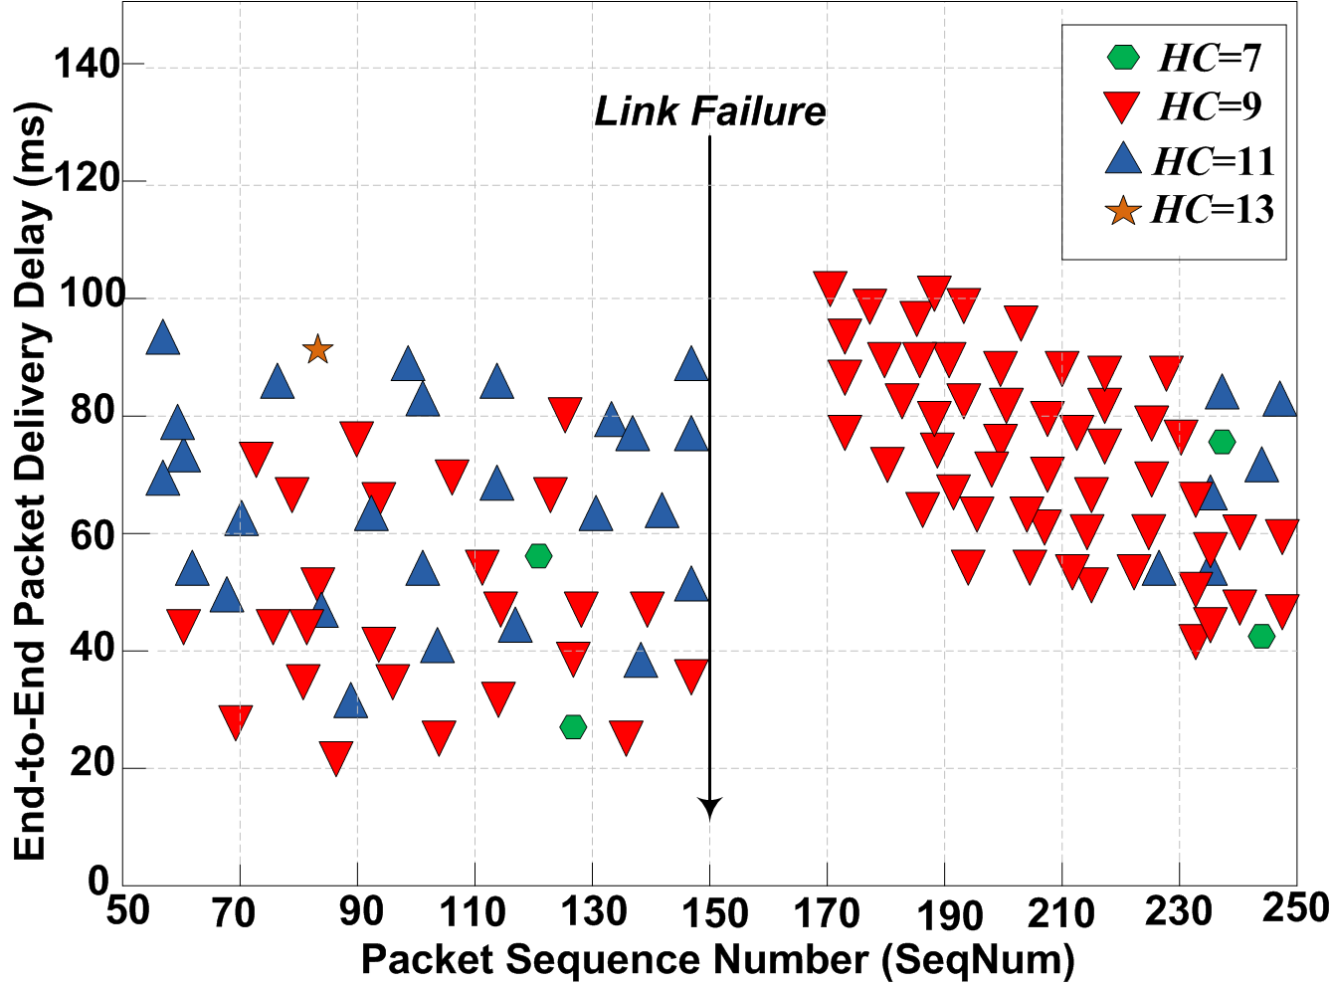
Experimental Observations (Cont.)
End-to-End Packet Delivery Delay
Since MultihopLQI keeps a state of one parent at a time, it is incapable of rapidly recovering from a broken route
The proposed responds quickly to recover from a broken route as it maintains an alternative route to compensate the failed one. This new constructed route is used temporarily as a backup route to deliver source-originated data packets in timely manner towards the base station. However, the hop count (hc) might increase
Route Recovery Delay in the Proposed Scheme
14
Route Recovery Delay in MultihopLQI

Slide 15
Experimental Observations (Cont.)
Routing Overhead
Over long run, the proposed scheme broadcasts fewer route/control messages as a result of minimising route message transmissions using adaptive beaconing. This leads to less energy consumed for route messages transmissions required for delivering data packets successfully towards the sink.
15

Slide 16
Simulations Results
Functional Network Lifetime
Due to the low volume of control and data packets transmitted throughout the network, the proposed scheme results in a slower and a more graceful linear degradation of the network lifetime.
16

Slide 17
Simulations Results (Cont.)
Average Dissipated Energy
The proposed scheme dissipates less energy for the same number of source nodes. The energy dissipation increases gradually as the number of generating nodes grows.
17

Slide 18
Simulations Results (Cont.)
Average Node Residual Energy
The proposed scheme reduces the redundant data copies in the network which results in lower traffic load handled by each individual forwarding node .
18

Slide 19
CONCLUSION AND FUTURE WORK
Conclusion
Improved reliability and packet delivery
Improved energy usage and efficient utilization of sensor node’s resources
Energy balance is beneficial for network lifetime extension
The proposed scheme consumes less energy while reducing topology repair
latency and supports various aggregation weights by redistributing packet relaying loads
It allows for adapting the amount of traffic to the fluctuations in network connectivity and energy expenditure
Ongoing work
Comparisons with energy-aware routing protocols
Adaptability to mobile wireless sensor networks

Slide 20
Any Questions?

